Slide 1


CEF440 – Internet and Mobile Programming
MOBILE APP FOR USER EXPERIENCE DATA COLLECTION
University of Buea, Faculty of Engineering & Technology
Mugha Brayan Aya-ah Ndefru • Ako McPeace Njoh • Eyong Akago Anelka Nelvine • Ngolien Lucy Ethel Libog

Slide 2

Problem Context
Mobile network subscribers in Cameroon face persistent connectivity challenges: slow internet speeds, unstable connections, weak signal strength, and frequent service interruptions that impact daily communication and productivity.
Mobile operators currently rely on technical QoS metrics, but these fail to capture real user experience (QoE). Despite existing monitoring systems, actual user perceptions of network quality remain unmeasured.

Slide 3
Project Objective
Objective Data (QoS)
Subjective Data (QoE)
Latency and jitter measurements
Packet loss detection
Signal strength monitoring
Throughput analysis
Combined QoE and QoS data provides complete network performance view
User ratings and satisfaction levels
Perceived network issues
Feedback on service quality
Mobile app runs in background for continuous monitoring

Slide 4
Requirements Gathering Approach
Our methodology was data-driven, using a structured questionnaire targeting mobile network subscribers in Cameroon, with over 50 responses Collected.
The systematic flow progressed from
Users → Questionnaire → Data Collection → Analysis → System Requirements.
Descriptive analysis techniques identified key patterns and trends in user behavior, technical environments, and privacy concerns. These insights were directly converted into actionable system requirements, ensuring our design decisions are grounded in real user data.

Slide 5
Targeted Data Types
Subjective Data (QoE)
Objective Data (QoS)
User-reported experience data:
• Perception and satisfaction ratings
• Feedback behavior patterns
• Interaction preferences
• Privacy concerns
• Issue reporting
Technical network metrics measured automatically:
• Latency and response times
• Jitter variability
• Throughput speeds
• Signal strength levels
• Packet loss rates

Slide 6
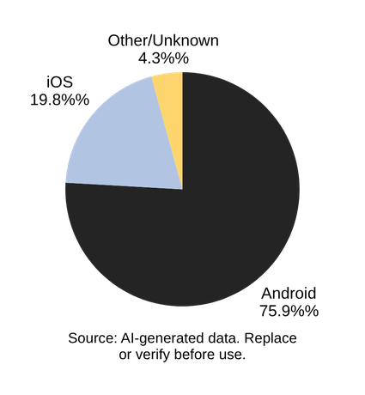
Key Findings – Technical Environment
Our survey reveals Android dominates with 75.9% of users, with half running Android 13 or newer. A minority of iOS users are also present. This device landscape necessitates cross-platform compatibility rather than an Android-only approach, ensuring maximum reach across the subscriber base.

Slide 7
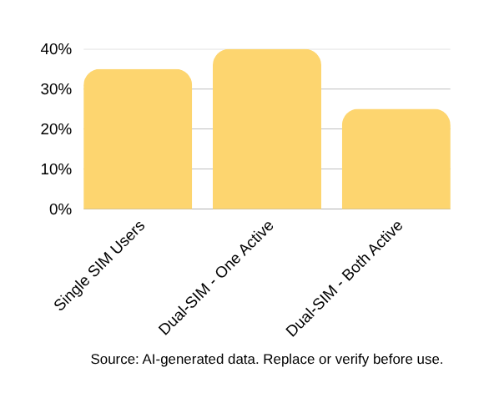
Key Findings – Technical Environment (Part 2)
Dual-SIM device usage is prevalent among Cameroonian mobile users. Many subscribers operate phones with two SIM cards, frequently switching networks based on availability, signal quality, and cost considerations. This behavior has critical implications for data collection accuracy—the app must detect which SIM is actively providing data connectivity to correctly attribute network performance metrics to the appropriate operator.

Slide 8
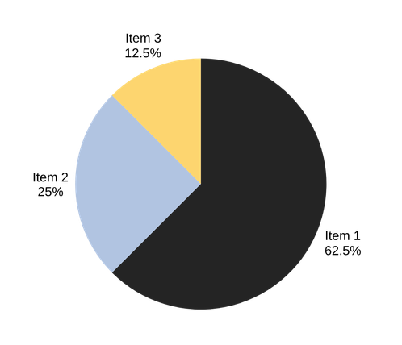
Key Findings – Network Experience Issues
Survey respondents reported significant network quality challenges affecting their daily mobile experience:
• Slow internet speeds – most frequently cited issue
• Weak signal strength in various locations
• Intermittent connectivity disruptions
• Problems occur across different times and areas
These findings justify continuous monitoring of latency, jitter, packet loss, and signal strength metrics.

Slide 9
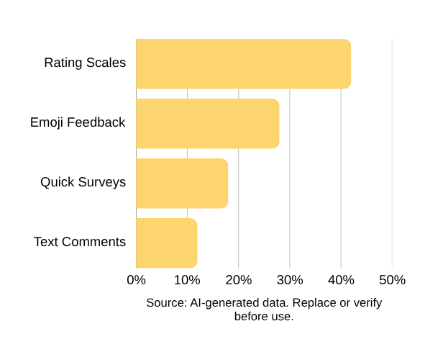
User Interaction Preferences
Users prefer minimal, non-intrusive interaction with the app. Most are willing to provide feedback occasionally, primarily after experiencing network issues. Simple methods are favored: rating scales and emoji feedback. Desired interaction time is under 10 seconds. Context-aware feedback triggering is essential for engagement.

Slide 10
Privacy and Trust Considerations
User Concerns: Location tracking, background monitoring, access to personal data, battery consumption transparency, and data usage visibility. Users expressed sensitivity about continuous data collection without clear communication.
Acceptance Factors: Transparency in data handling, user control over permissions, strict anonymization protocols, minimal data collection principles. Privacy Measures: Explicit data access statements, granular permission management, clear opt-in/opt-out mechanisms.

Slide 11
System Constraints
Limited Battery Life
Energy-Efficient Design
Low-End Device Support
Minimal Background Activity
Unstable Connectivity
Offline Storage & Sync
Device Fragmentation
Low Data Usage

Slide 12
Data Analysis Approach
Descriptive analysis was applied to over 45 quantitative survey responses to detect trends and patterns. The analysis focused on four key areas: technical environment, user behavior, privacy concerns, and operational constraints.
Survey insights were directly translated into actionable system requirements. This data-driven methodology ensured that design and technology decisions were grounded in real user needs and constraints.

Slide 13
Drawing Conclusions from Analysis
Platform & UI Decisions
Data & Privacy Strategy
Android dominance (75.9%) with iOS presence drove cross-platform development choice via React Native. UI design shaped by user preference for minimal, fast interactions under 10 seconds with simple feedback methods.
Data collection balances continuous background monitoring with energy efficiency. Active SIM detection critical for dual-SIM attribution. Privacy model emphasizes strict anonymization, transparency, and granular user control.

Slide 14
Technology Decisions – Frontend
React Native with Expo was selected for cross-platform compatibility, enabling a single codebase for both Android and iOS. This approach significantly reduces development complexity and time while maintaining native performance where needed.
Native module integration using Kotlin for Android and Swift for iOS enables performance-critical network measurements. React Native handles user interaction and visualization layers, while all network measurements are performed directly on the mobile device for accuracy.

Slide 15
Technology Decisions – Backend
Node.js with Express chosen for scalable, event-driven request handling. Efficient real-time data ingestion from mobile clients. Backend processes, validates, and stores anonymized network performance data.
RESTful API architecture for data reception and retrieval. MongoDB selected for scalable, flexible document storage. Secure HTTPS communication ensures data integrity. Backend receives and stores measurement results only—does not perform network tests.

Slide 16
Language and Localization
Survey results reveal clear language preferences among mobile network subscribers in Cameroon. 49.1% of users prefer English, while 43.4% are bilingual in English and French, with a minority preferring French only. Based on these findings, the app will default to English with a built-in language toggle enabling seamless switching to French. This bilingual support is critical for ensuring accessibility across the Central African user base and maximizing adoption rates.

Slide 17
User Motivation and Adoption
Users are more likely to keep the app if they see personal network insights. Dashboards showing personal network performance over time drive retention.
Visualization and actionable insights increase perceived value. Transparent data use fosters trust and ongoing engagement with the application.

Slide 18
Conclusion
This requirements analysis established a comprehensive understanding of the technical environment, user expectations, and operational constraints. The resulting technology stack combines React Native with Expo and native modules for cross-platform frontend development, with Node.js, Express, and MongoDB powering the backend infrastructure.
Key architectural principles include client-side network measurements for accuracy, a privacy-first approach with user control and anonymization, and energy-efficient offline-capable design. The outcome is a scalable, accurate, and user-centered system for collecting both QoE and QoS data from mobile network subscribers.

Slide 19

Thank You
Questions?

